Slide 1
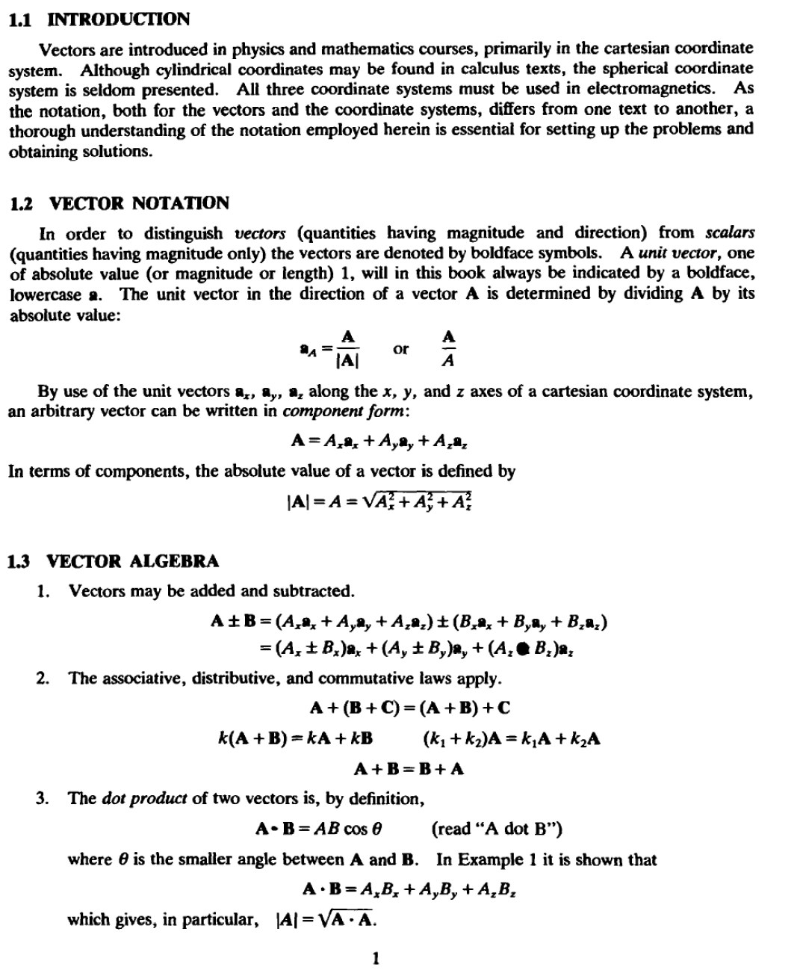
Lecture one/ Vector analysis

Slide 2
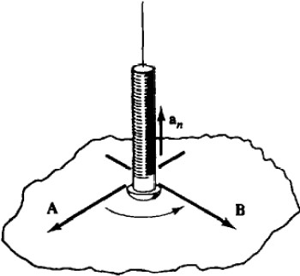
2
VECfOR ANALYSIS
(OIAP. 1
EXAMPLE 1. lbe dot product obeys the distributive and scalar multiplication laws
A • (B+C) A • 8 +A • C
A • kB =k(A • B)
This being the case,
A·8-= (A..a.. + A,.a,. +A,a.)·(B..a.. + B,.a,. + B,a.)
- A..B..(a..• a..)+ A,.B,.(a,. • a,.)+ A,B.(a.. •a.)
+A..B,.(a.•a,.)+· ··+A.B,.(a. ·a,.)
However, a.• a.. = a,. •a,. = a. • a.= 1 because the cos 8 in the dot product is unity when the angle is
zero. And when 8 =90", cos 8 is zero; hence all other dot products of the unit vectors are zero. Thus
A·8 = A,.B.. +A,.B,. +A,B.
4. The cross product of two vectors is, by definition,
A X B= (ABsin 8)a,. (read ..A cross B")
where 8 is the smaller angle between A and B, and a, is a unit vector normal to the plane determined by A and B when they are drawn from a common point. There are two normals to the plane, so further specification is needed. The normal selected is the one in the direction of advance of a right-hand screw when A is turned toward B {Fig. 1-1). Because of this direction requirement , the commutative law does not apply to the cross product ; instead,
AXB=-BXA
tlx.. 1-1
Expanding the cross product in component form,
A X B = (A...a.. +A,.a,. +Azaz) X (B..a... + B,.a,. + Bzaz)
= (A,.Bz -AzB,.)a.., + (AzB.. -A..B,)a... + (A_.B... -A,.B_.)a,
which is conveniently expressed as a determinant:
...
AXB= A_..
B..

Slide 3
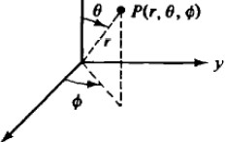
CHAP. 1]
VECfOR ANALYSIS
3
EXAMPLE 2. Given A ""2a.. +4a,. -
and B == a..-a,.. find A • B and A x B.
A • B = (2)(1) +(4)(-1) +(-3)(0) = -2
AXB-=
a.. a,. a.
2 4 -3 =-3a.. -3a,. -6a.
1 -1 0
1.4 COORDINATE SYSTEMS
A problem which has cylindrical or spherical symmetry could be expressed and solved in the familiar cartesian coordinate system. However, the solution would fail to show the symmetry and in most cases would be needlessly complex. 'Iberefore, throughout this book, in addition to the cartesian coordinate system, the circular cylindrical and the spherical coordinate systems will be used. AU three will be examined together in order to illustrate the similarities and the differences .
A point Pis described by three coordinates, in cartesian (x, y, z), in circular cylindrical (r, q,, z),
and in spherical (r, 6, ,P), as shown in Fig. 1-2. The order of specifying the coordinates is important and should be carefully followed. The angle q, is the same angle in both the cylindrical and spherical systems. But, in the order of the coordinates, tP appears in the second position in cylindrical, (r, q,, z), and the third position in spherical, (r, fJ, q>). The same symbol, r, is used in both cylindrical and spherical for two quite different things. In cylindrical coordinates r measures
the distance from the z axis in a plane normal to the z axis, while in the spherical system r measures the distance from the origin to the point. It should be clear from the context of the problem which r is intended.
z z
z
P(x,y ,z)
r P(r, . z)
I
: z
-+----+- Y
I
Iz
/-- .._'7'"""_ y
_ _ ,;./ J"x
I ,
y
X
(o) Cartesian
X
(b}Cylindrical
(c) Spherical
fl&. 1·1
A point is also defined by the intersection of three orthogonal surfaces, as shown in Fig. 1-3. In cartesian coordinates the surfaces are the infinite planes x =const., y = const., and z = const . In cylindrical coordinates, z = const. is the same infinite plane as in cartesian; q, =
const. is a half plane with its edge along the z axis; r = const. is a right circular cylinder. These
three surfaces are orthogonal and their intersection locates point P. In spherical coordinates. q, =
const. is the same half plane as in cylindrical; r = const. is a sphere with its center at the
origin; 6 = const. is a right circular cone whose axis is the z axis and whose vertex is at the
origin. Note that 8 is limited to the range 0s6 srr.
Figure 1-4 shows the three unit vectors at point P. In the cartesian system the unit vecton have fixed directions, independent of the location of P. This is not true for the other two systems (except in the case of a,). Each unit vector is normal to its coordinate surface and is in the direction in which the coordinate increases. Notice that all these systems are right-handed:
.... x a,.= a,
a,.x a., =•,

Slide 4
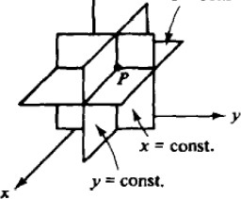
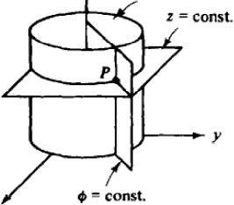
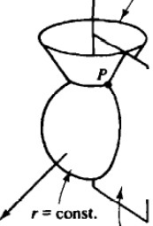
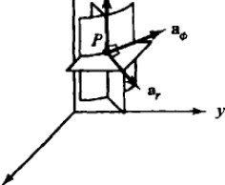
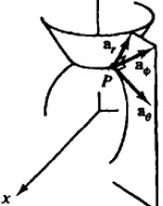
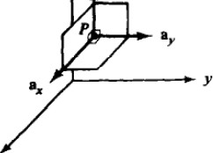
4
VECTOR ANALYSIS
(CHAP. 1
z
z
r = const.
z
6"' const.
z = const.
1---.,_y
X
X
:: const.
(a) Cartesian
(b)Cylindrical
(c) Spherical
f'll· 1-3
1be component forms of a vector in the three systems are
A= A, a, +Ayay +Az•z A= A,.a, +A••• +A,az A= A,.a, +A₆a₆ +A.,.a.
(cartesian) (cylindrical) (spherical)
It should be noted that the components A, , A,, A•• etc., are not generally constants but more often are functions of the coordinates in that particular system.
z
z
z
••
-y
X
X
(a)Cartesian
(b) Cylindrical
(c) Spherical
FIJ. 1-4
1.5 DIFFEREN11AL VOLUME, SURFACE, AND LINE ELEMENTS
There are relatively few problems in electromagnetics that can be solved without some son of integration-along a curve, over a surface, or throughout a volume. Hence the corresponding differential elements must be clearly understood.
When the coordinates of point P are expanded to (x +dx, y + dy, z +dz) or (r +dr, 4> +
dcp, z +dz) or (r +dr, 8 +d8, cp +dcp), a differential volume dv is formed. To the first order in
infinitesimal quantities the differential volume is, in all three coordinate systems, a rectangular
box. The value of dv in each system is given in Fig. 1-5.

Slide 5
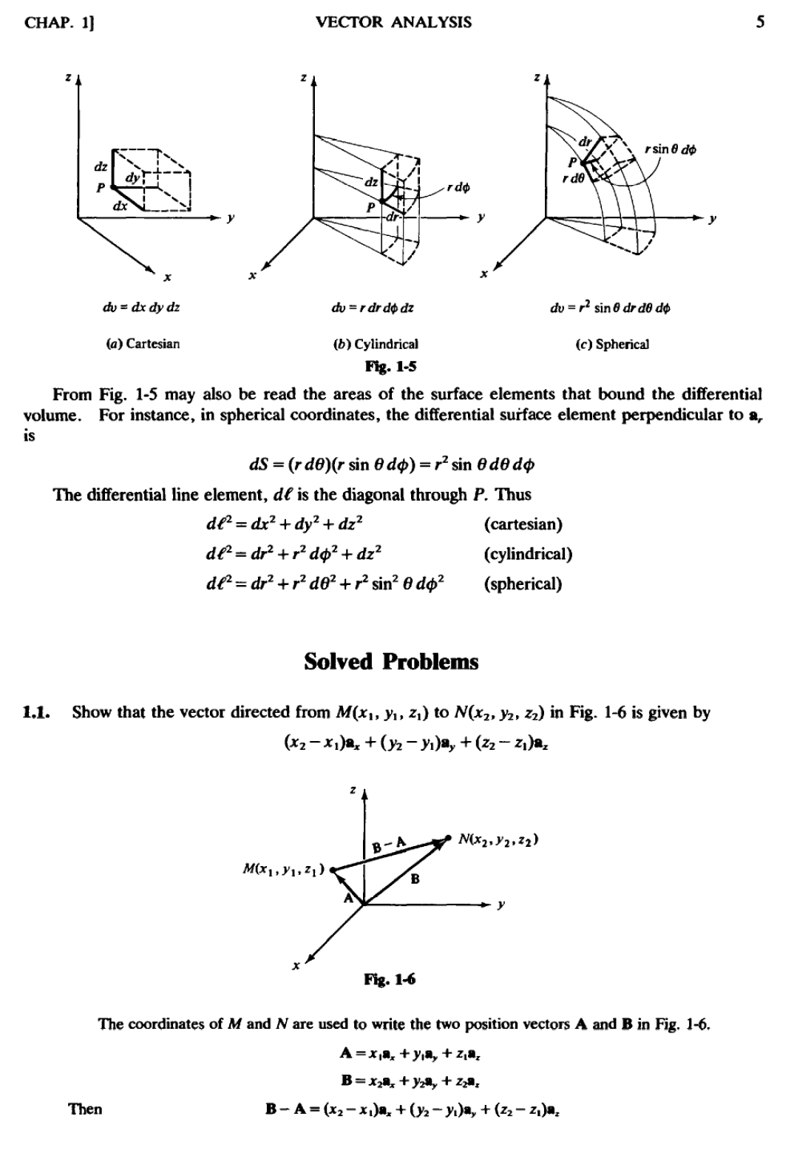

Slide 6
